Slide 1
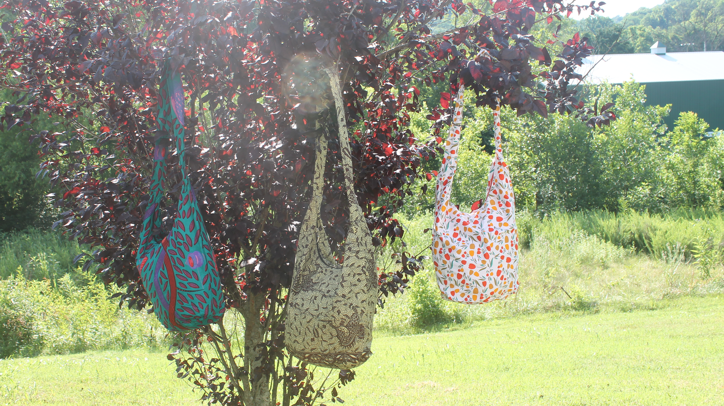
MIDTERM PROPOSAL

Slide 2
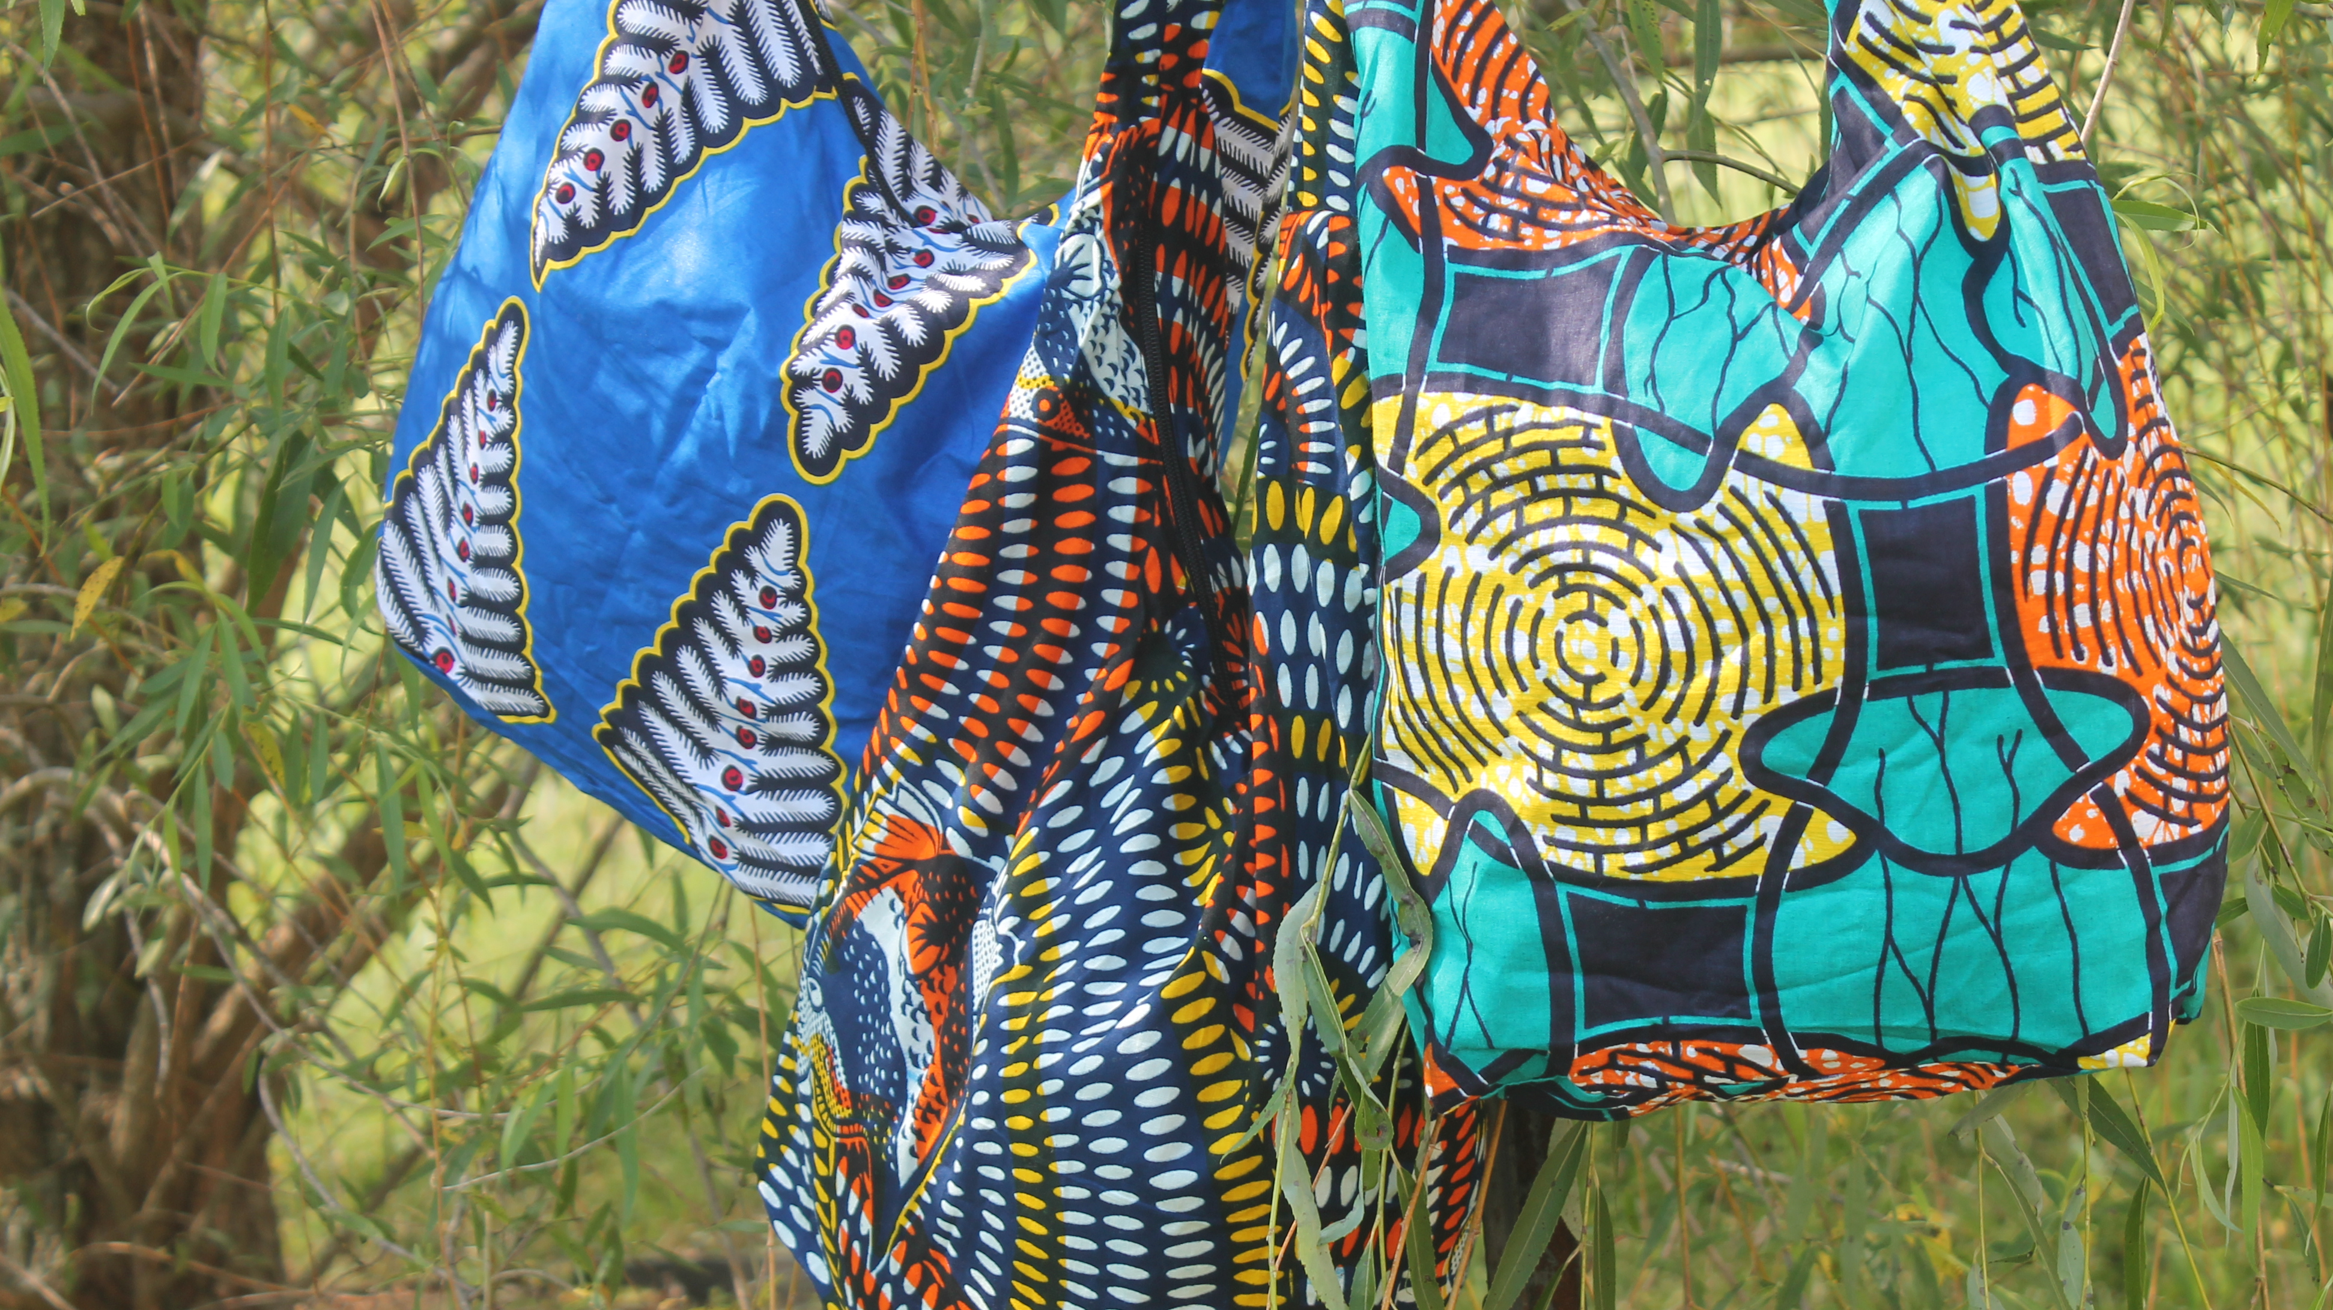
CONCEPT
My midterm project will be a work in progress website for my friend’s social enterprise. The enterprise is called Esther Nzuzi which sells purses on Etsy and uses10% of the profits to the raise money for as many sewing machines as possible for Luila Village Ministries in the Democratic Republic of Congo.

Slide 3
Skills we Learned
Menu/Nav Bar
Page Linking
Google fonts
Positioning
Inline Block
CSS styling
Hover effects

Slide 4
Skills I NEED TO LEARN
Adding a slideshow
Scroll to different parts of page by clicking a button
Adding a video background
Creating a pop-out window for Quick View of products

Slide 5
WEBSITE iNSPIRATIONS
https://luilavillage.org (slideshow)
https://www.forever21.com/us/shop/Catalog/Category/f21/app-main (quick view)
https://wearelane.com (Front page)

Slide 6
SITE MAP
Home Page
SHOP
ABOUT
WHO WE ARE
CONTACT
VALUES
PHILANTHROPY
TEAM

Slide 7



Slide 8
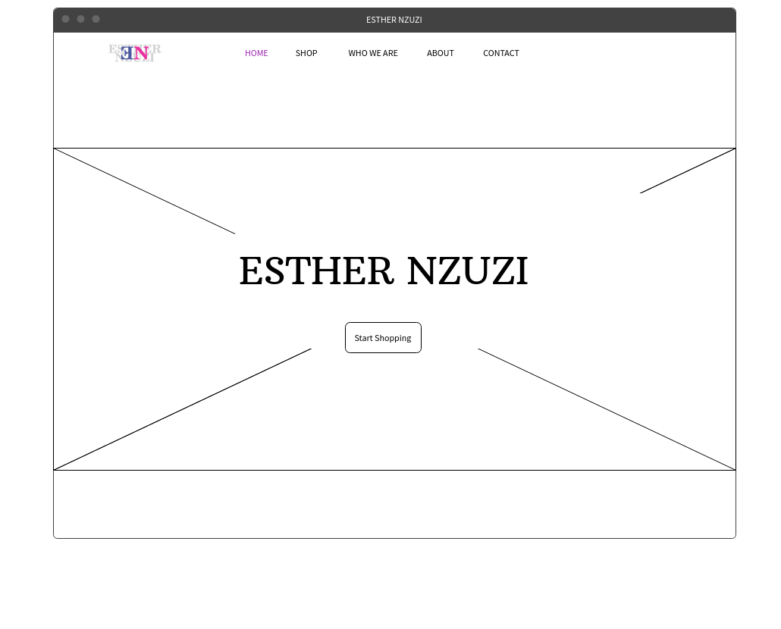

Slide 9
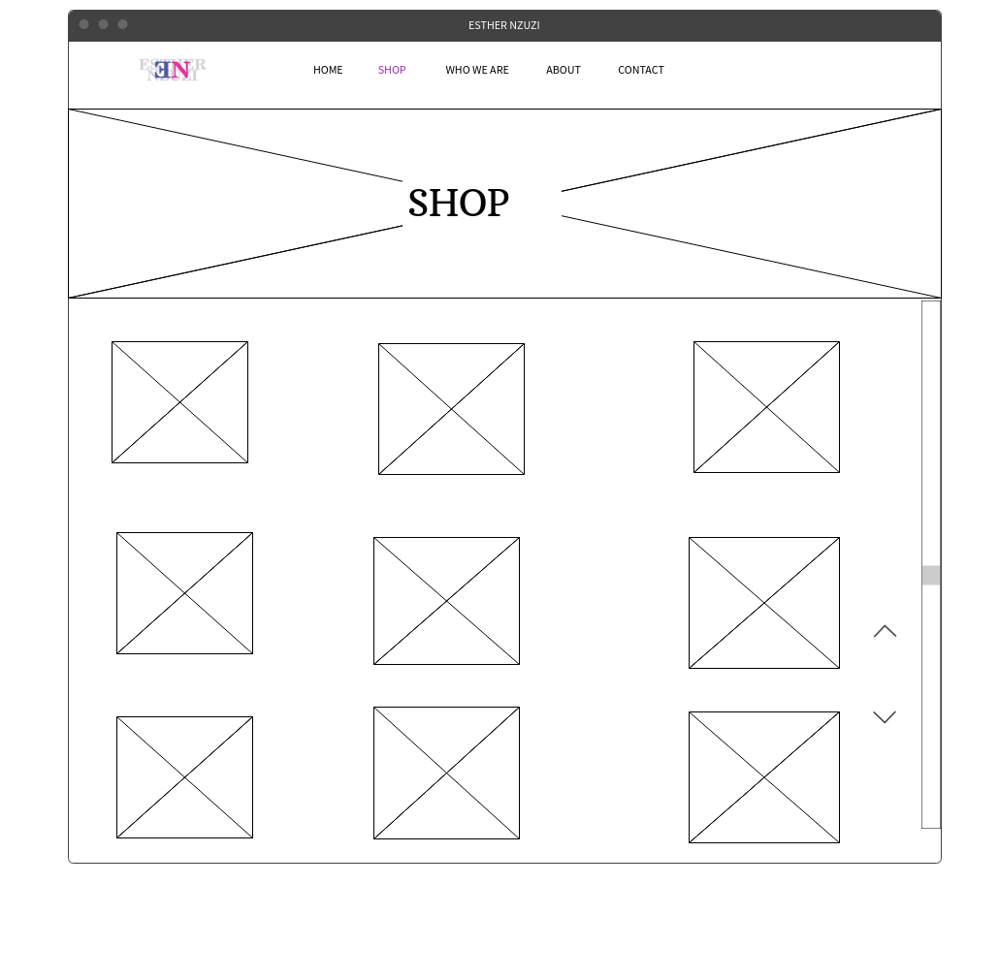

Slide 10
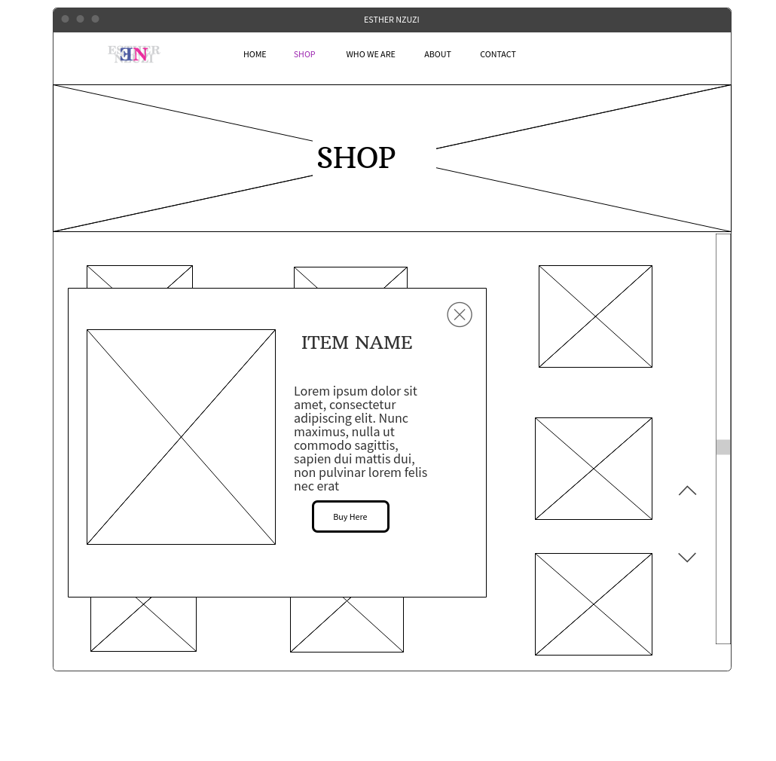


Slide 11
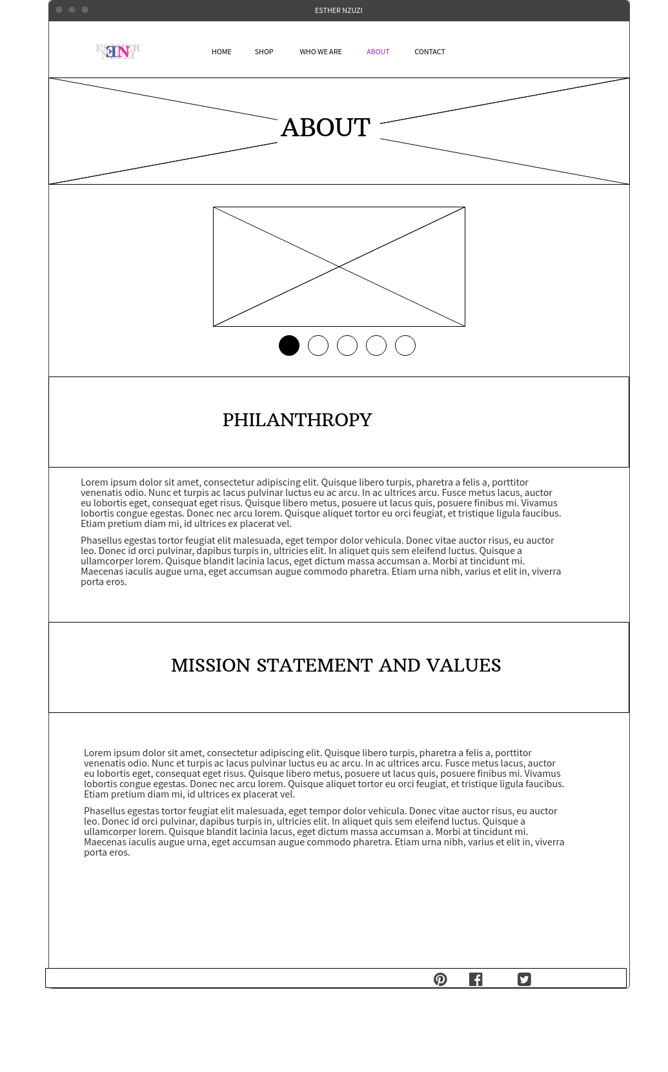

Slide 12
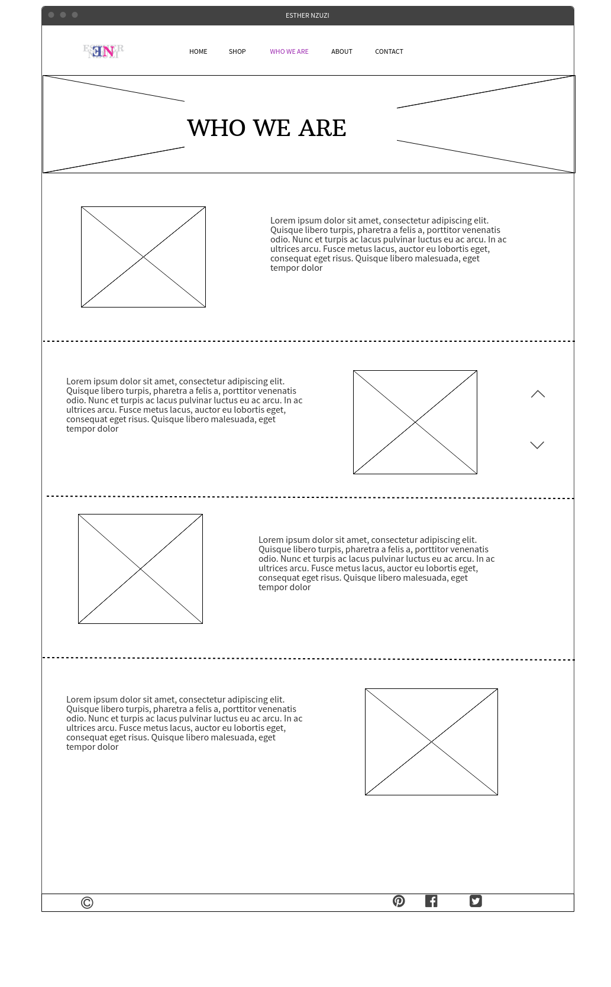

Slide 13
